Slide 1


Slide 2
Safety first!
Pilots:
stay hydrated & cool, use sunscreen
use tested life jacket
keep your boat dry
stay all times within 500 mtr radius from shoreline.
Captains:
when in doubt, ask!
While teammate on water be present in jury tent and connect to whatsapp group

Slide 3
Jury tent
Join whatsapp group “SSO Hungary 2025”
1 teammember in contact with pilot at all times when boat afloat
Location: in tent at peer at event area

Slide 4
Slipway rules:
Be in time to go and get into water. There will be a line.
No time to do alternations at slipway before racing.

Slide 5
Date | Start | Race element | Finish | Start procedure | Finish procedure
22 aug | 10:10 | Time trail | 14:30 | Le Mans | Mark A- finish
 | 16:00 | Slalom race | 17:00 | C | Finish
23 aug | 10:10 | Endurance | 15:00 | A | Mark A- finish
 | 16:00 | Top speed | 16:30 | B | Finish
 | 19:00 | Parade | 21:00 | A | Finish
24 aug | 10:10 | Ton’s Race | 13:00 | A | Mark A- finish
 | 14:00 | Matchrace | 16:00 | C | Finish

Slide 6
Racenr | Team name
O01 | Solar Boat Twente
O02 | Sunflare Solarteam
O03 | University of Pannonia
O04 | HAN Solarboat
O05 | Stichting Spectrum Solarteam
O06 | AGH Solarboat
O07 | WhisperPower Solar Team
O08 | Hi-Horizon Racing Team
O09 | BME Solarboat Team
O10 | HVHL-Aeres
O11 | GUT Solar Boat Team

Slide 7
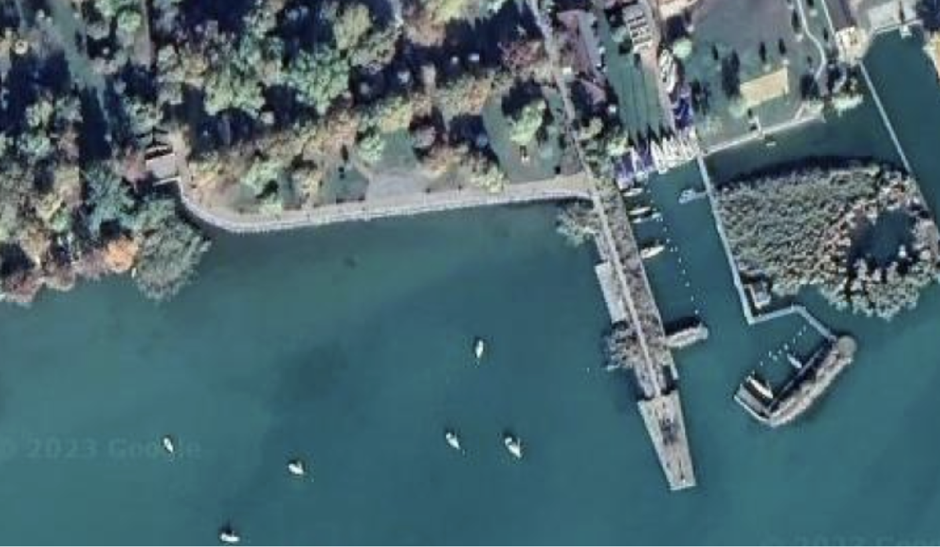
Event area
A:
start, finish
& hold area
Slibway
Mark A
Crisis centre
& race office
Holding area

Slide 8
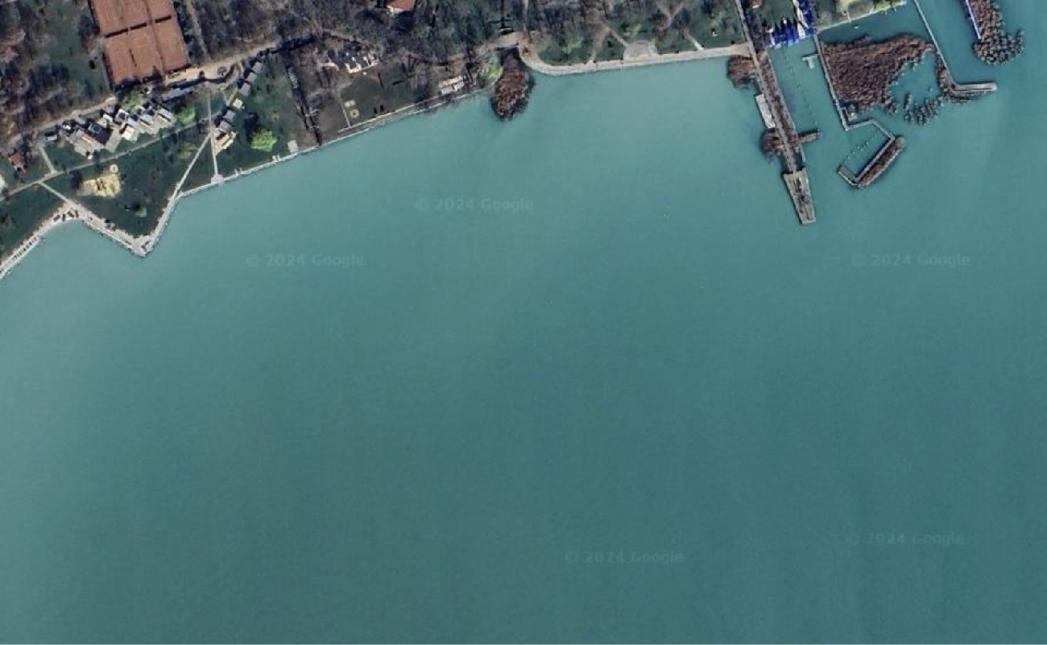
Event area
B:
start, finish
& hold area
Holding area

Slide 9
Event area
C:
start, finish
& hold area
Slibway
Crisis centre
& race office
Mark A
Holding area

Slide 10
Start procedure endurance, Ton’s race, slalom & matchrace:
Go to waiting area
Pass by starting line & be acknowledged
1 min to start = +
Start =
Finish =
+

Slide 11
Start procedure top speed:
Go to waiting area
Pass by starting vessel & be acknowledged
Time to start will be called by race official
Start =
Finish =
+
x

Slide 12
Marks/ platforms
Marks will be inflatable red ones
Start/ finish flags can be placed on shore or in boat on water.
Near by the platforms are red marks.
The position of the platforms/marks are:
1 | 46°57'30.00"N | 17°55'27.0"E | Balatonfüred, BAHART from harbour 600* and 595 m – Mark
SF | 47°01’31.92"N | 18°01'13.62"E | Balatonalmádi, BAHART harbour 300 m – Gate
3 | 47°01'45.98„N | 18°05'26.71"E | Balatonkenese, Kenese Marina Port 800 m – Mark
4 | 46°58'56.81"N | 18°08'09.47"E | Balatonaliga, Aliga Port 800 m – Mark
5 | 46°56'37.18"N | 18°05'29.63"E | Siófok, 800 m – Mark

Slide 13
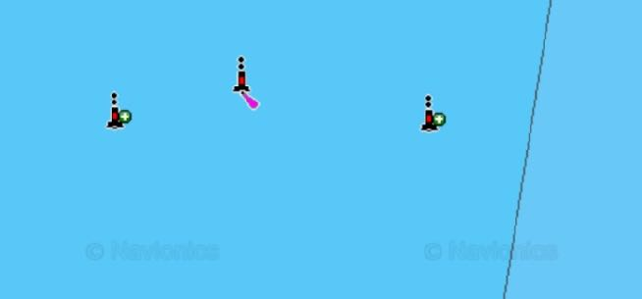
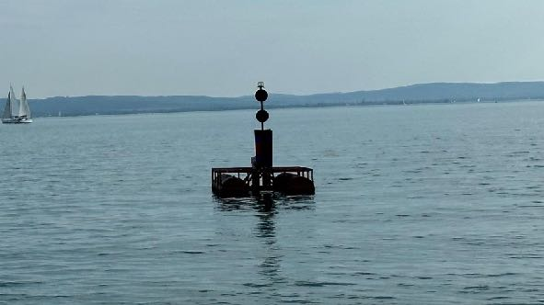
Marks SF, 3 &4 are nearby pantoons
Mark 1:
1 | 46°57'30.00"N | 17°55'27.0"E
link

Slide 14
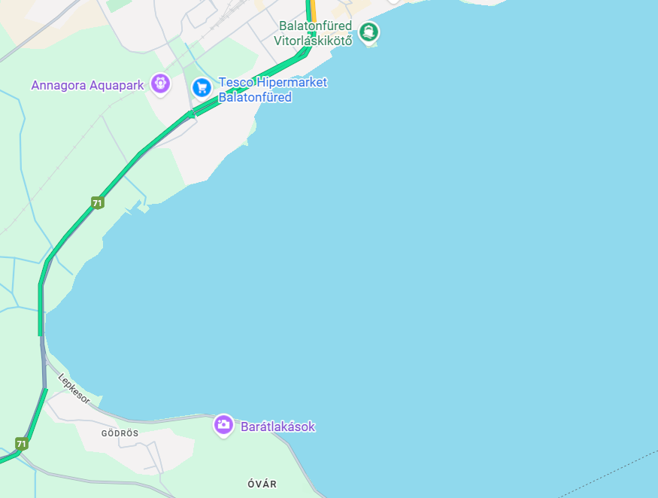
Mark 2:
2 | 46°55'50.0"N | 17°52'10.5"E
link

Slide 15
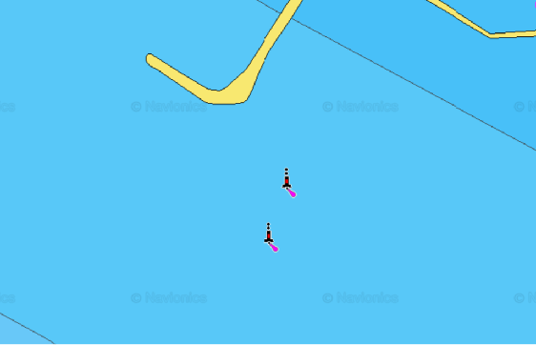
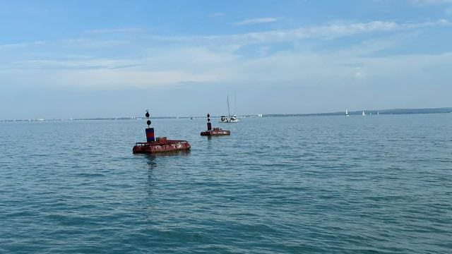
Marks SF, 3 &4 are nearby pantoons
Mark 3:
3 | 46°58'56.81"N | 18°08'09.47"E
link

Slide 16
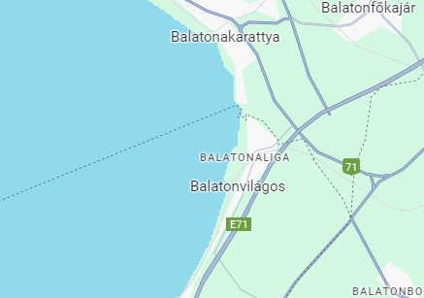
Marks SF, 3 &4 are nearby pantoons
Mark 4:
4 | 46°58'56.81"N | 18°08'09.47"E
link

Slide 17
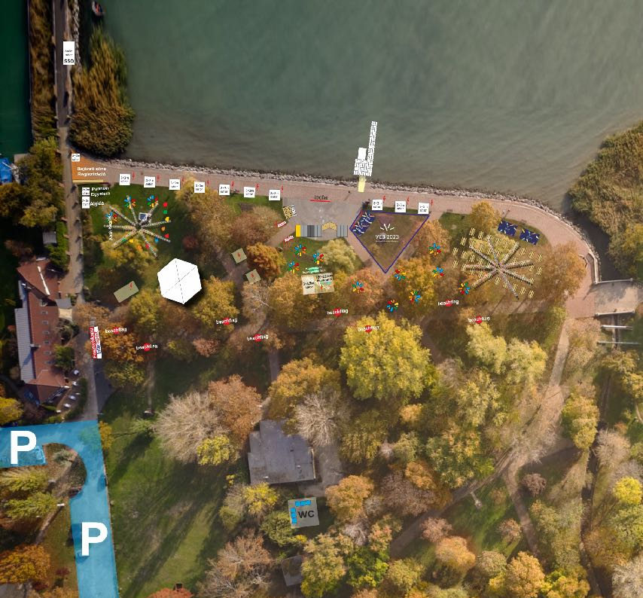
Time Trial
Le Mans start
1 heat
startmark

Slide 18
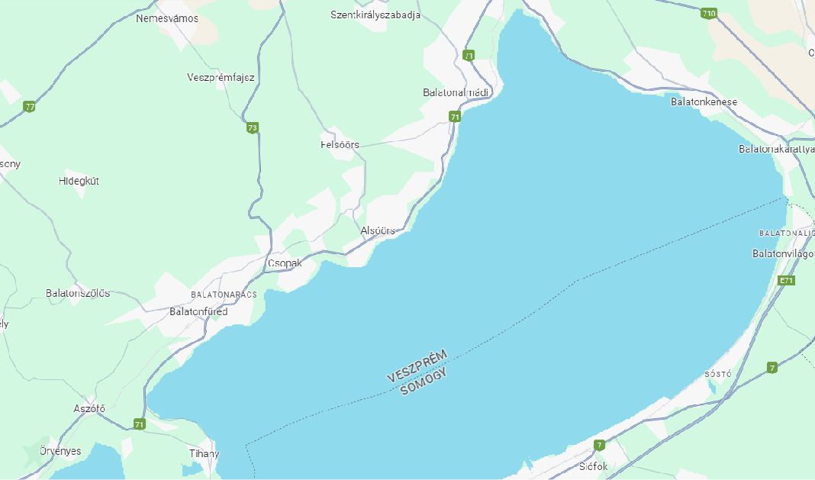
Time trail (approx. 52 km)
Start n# | Round
Mark A | Port side
SF | Gate
1 MARK | Port side
2 MARK | Port side
1 MARK | Starboard side
SF | Gate
3 MARK | Starboard side
4 MARK | Starboard side
4 MARK | Port side
3 MARK | Port side
SF | Gate - FINISH
SF
3
4
1
2

Slide 19
Slalom Race
total distance 2x 180 mtr
Two courses aprox. 50 mtr apart

Slide 20
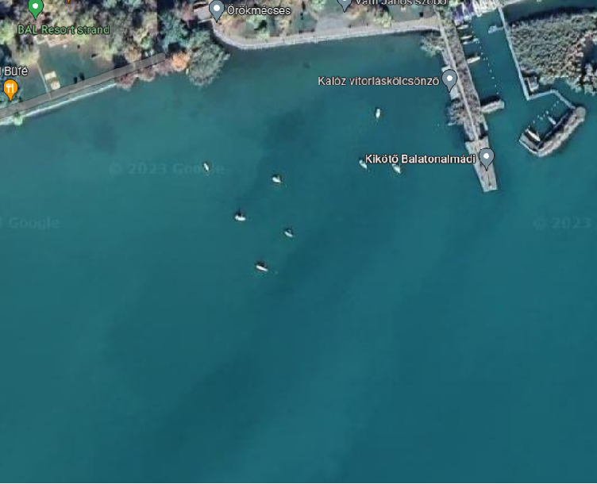
Slalom Race
Course A | Course B
Start | Start
1 port | 5 port
2 starboard | 6 starboard
3 port | 7 port
4 starboard | 8 starboard
3 port | 7 port
2 starboard | 6 starboard
1 port | 5 port
Finish | Finish
Holding area
1
2
3
5
4
6
7
8
Start schedule on next slide
2 teams start simultaneously
Each team does course a and course b
Total time of course A and B will be your result

Slide 21
Endurance
10:10
Start A - SF - 1 (port) - SF - 3 (port) - SF
After 12:30
SF - 3 (sb) - 4 (sb) - SF
After 14:00
1 (sb) - mark A - finish
SF
3
4
1

Slide 22
Endurance
1 mandatory 10 min stop anytime at dock
pilot change is allowed

Slide 23
Speedrace
Each team 2 attempts
We’ll let you know if we did not have an official reading of your time.
Sail head to peer

Slide 24
Ton’s race
Your race distance is the sum of all the sailed legs. Possible legs are:
SF-5 1.63km
SF-1 6.95km
SF-3 6.06km
3-4 5.73km
After the finish give us a list of legs you competed
You can only sail a leg more then twice if you sailed at least 3 different legs.
SF
3
4
5
1

Slide 25
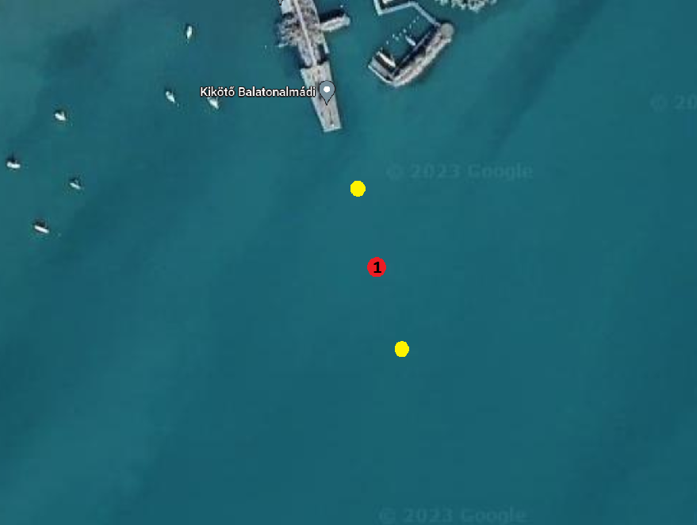
Ton’s race start
Start in any direction

Slide 26
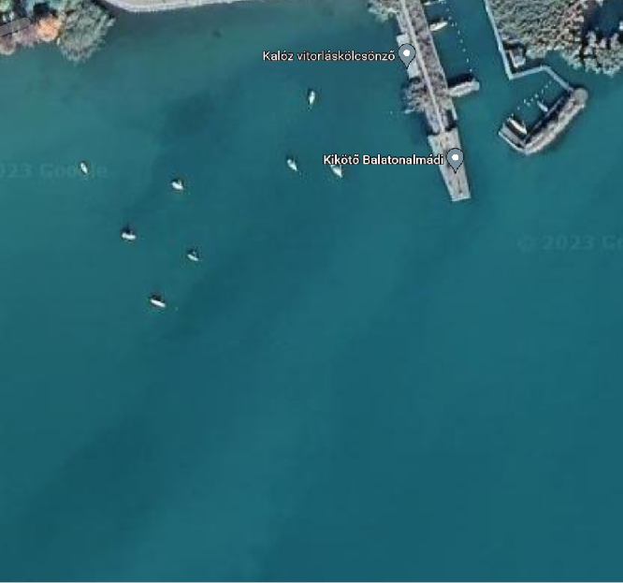
Matchrace
Course A 2 portside | Course B 2 starboard
Start | Start
5 | 3
4 | 2
1 | 1
2 | 4
3 | 5
Finish | Finish
Holding area
4
3
1
5
2
(mark 2 approx 400 mtr)
Start schedule according to preliminary results

Slide 27
Matchrace
stage | race | course A | course B
1 | 1 | O03 | O16
1 | 2 | O18 | O02
1 | 3 | O11 | O15
1 | 4 | O07 | O05
1 | 5 | O17 | O14
2 | 6 | 9 | 10
3 | 7 | 1 | 8
3 | 8 | 2 | 7
3 | 9 | 3 | 6
3 | 10 | 4 | 5
4 | 11 | R10L | R7L
4 | 12 | R9L | R8L
5 | 13 | R7W | R10W
5 | 14 | R8W | R9W
6 | 15 | R11L | R12L
7 | 16 | R12W | R11W
8 | 17 | R14L | R13L
9 | 18 | R13W | R14W
Stage 1: time trail, you will sail for the fastest time
Stage 2: place 9&10 from stage 1 will race for place 9
Stage 3: quarterfinals, result from stage 1: 1vs8, 2vs7, 3vs6, 4vs5
Stage 4: repicharge losers from stage 3
Stage 5: semi finals: winners from stage 3
Stage 6: losers from stage 4, winner get`s 7th place, loser 8th
Stage 7: winners from stage 4, winner gets 5th place, loser 6th
Stage 8: petit final, losers of stage 5, winner is 3rd, loser 4th
Stage9: final, winners of stage 5, winner is 1st, loser 2nd

Slide 28
Parade
Let’s stay in a group and make some entertainment…
Boats will be stay close to the shore. Special prize for most decorated boat!
SF

Slide 29
Extra info:
Official communication whatsapp group!
Race will be covered through Estella, so download the app!
- Race officer: Julianna Kristóf
- Coordinator jury tent: ___________________
Emergency: 112
- plz use @solarsportone in your socials

Slide 30
ENJOY

