Slide 1

Race Advance Program
CoreComm Solar Boat Challenge 2026
Balatonalmádi, Hungary
28–30 August 2026

Slide 2

Safety First!
Stay hydrated & cool, use sunscreen
Use tested/approved life jacket
Keep your boat dry
Stay within 500 m of the shoreline at all times
Captains:
  When in doubt, ask!
  While teammate is on water, be present in jury tent and connect to WhatsApp group

Slide 3
Jury Tent
Join WhatsApp group “Solar Boat Race Hungary 2026”
One team member in contact with pilot at all times when boat is afloat
Location: in the tent at the pier in the event area

Slide 4
Slipway rules
Arrive on time to launch. There may be a queue.
No modifications at the slipway before racing.

Slide 5
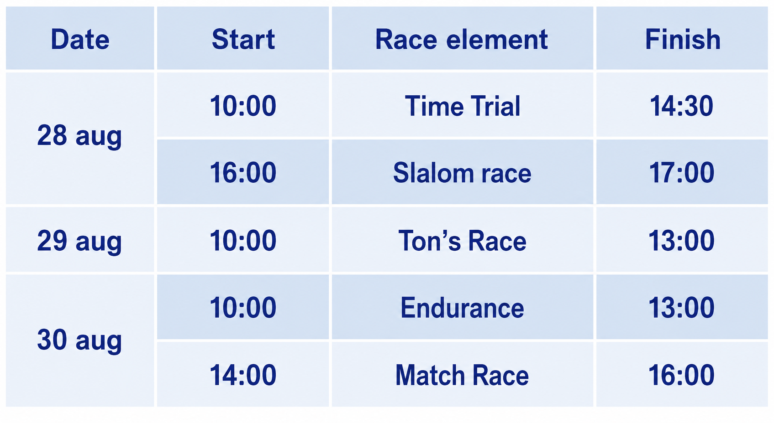

Slide 6
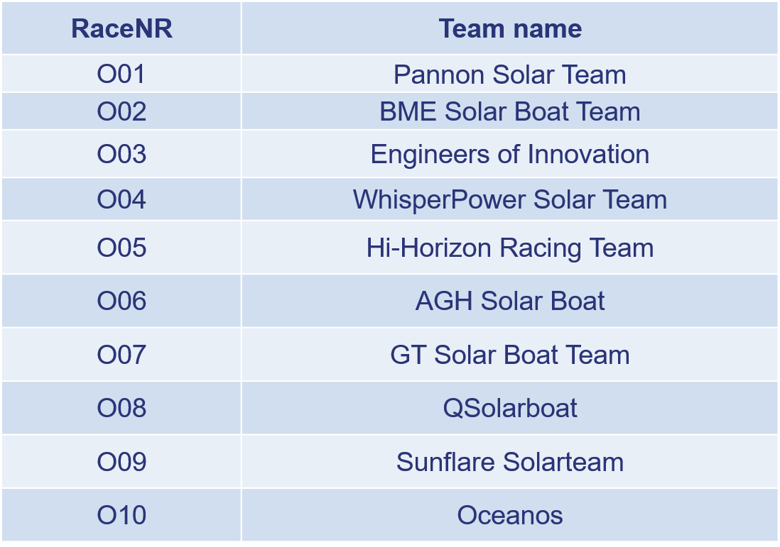

Slide 7
Start procedure for Endurance, Ton’s Race, Slalom and Match Race:
Go to waiting area
Pass by starting line & be acknowledged
1 min to start =
Start =
Finish =

Slide 8
Marks and Platforms
Marks will be inflatable red ones
Start/ finish flags can be placed on shore or in boat on water.
Nearby the platforms are red marks.
The positions of the platforms/marks are:
1 | 46°57'30.00"N | 17°55'27.0"E | Balatonfüred, BAHART from harbour 600* and 595 m – Mark
SF | 47°01'31.92"N | 18°01'13.62"E | Balatonalmádi, BAHART harbour 300 m – Gate
3 | 47°01'45.98"N | 18°05'26.71"E | Balatonkenese, Kenese Marina Port 800 m – Mark
4 | 46°58'56.81"N | 18°08'09.47"E | Balatonaliga, Aliga Port 800 m – Mark
5 | 46° 58' 52.30"N | 17° 58' 57.62"E | Alóörs Marina - BAHART harbour 600 m - Mark

Slide 9
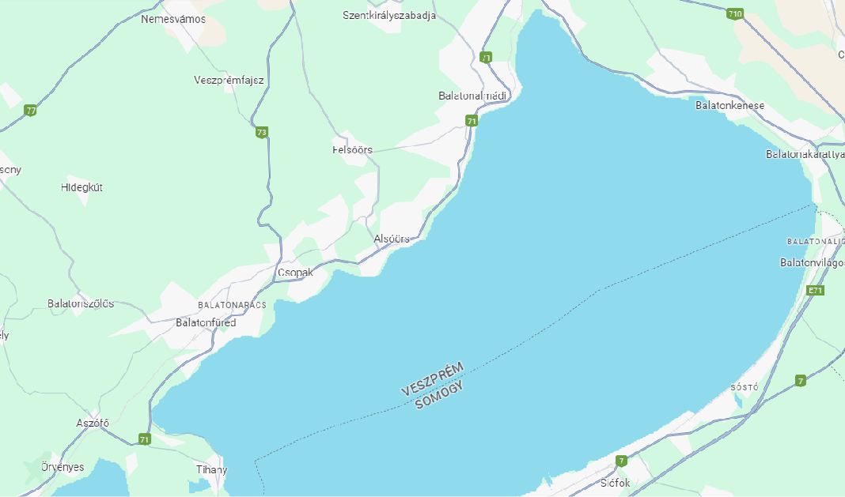
Time trial (approx. 52 km)
Start n# | Round
Mark A | Port side
SF | Gate
1 MARK | Port side
2 MARK | Port side
1 MARK | Starboard side
SF | Gate
3 MARK | Starboard side
4 MARK | Port side
3 MARK | Port side
SF | Gate - FINISH
Le Mans start
SF
3
4
1
2

Slide 10
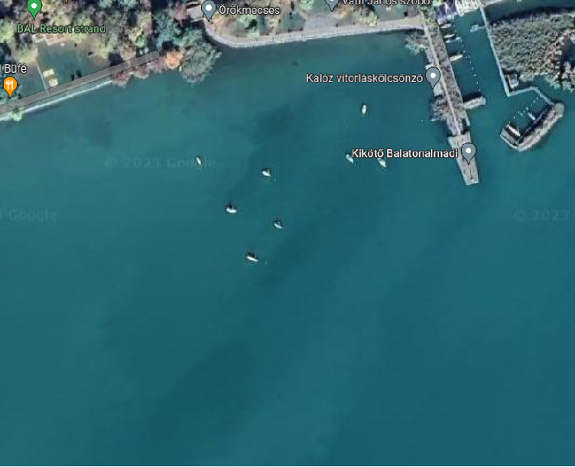
Slalom Race
Course A | Course B
Start | Start
1 port | 5 port
2 starboard | 6 starboard
3 port | 7 port
4 starboard | 8 starboard
3 port | 7 port
2 starboard | 6 starboard
1 port | 5 port
Finish | Finish
Holding area
Total distance 2 x 180 m
Two courses aprox. 50 m apart
2 teams start simultaneously
Each team does course A and course B
Total time of course A and B will be your result
Holding area
1
2
3
4
5
6
7
8

Slide 11
Endurance
SF
3
10:00
Start A - SF - 1 (port) - SF - 3 (port) - SF
After 12:30
SF - 3 (sb) - 4 (sb) – 3 (port) - SF
After 13:00
1 (sb) - mark A - finish
4
1

Slide 12
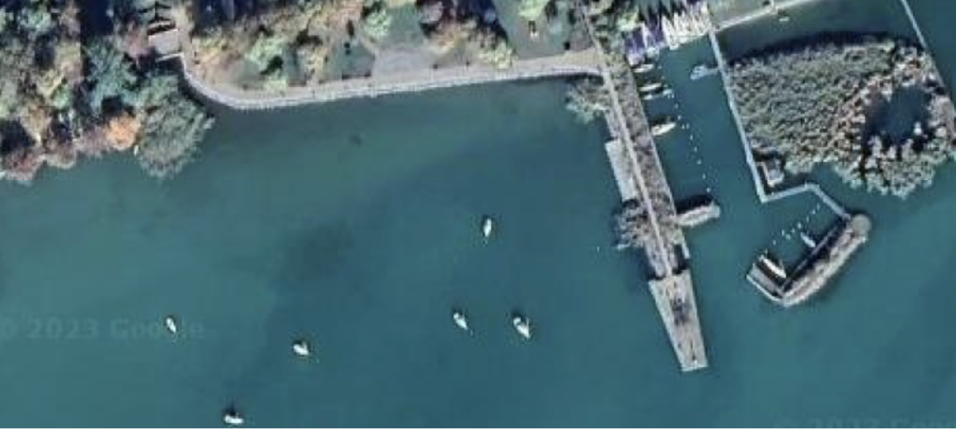
Endurance
1 mandatory 10 min stop anytime at dock
pilot change is allowed
SF
3
4
5
1

Slide 13
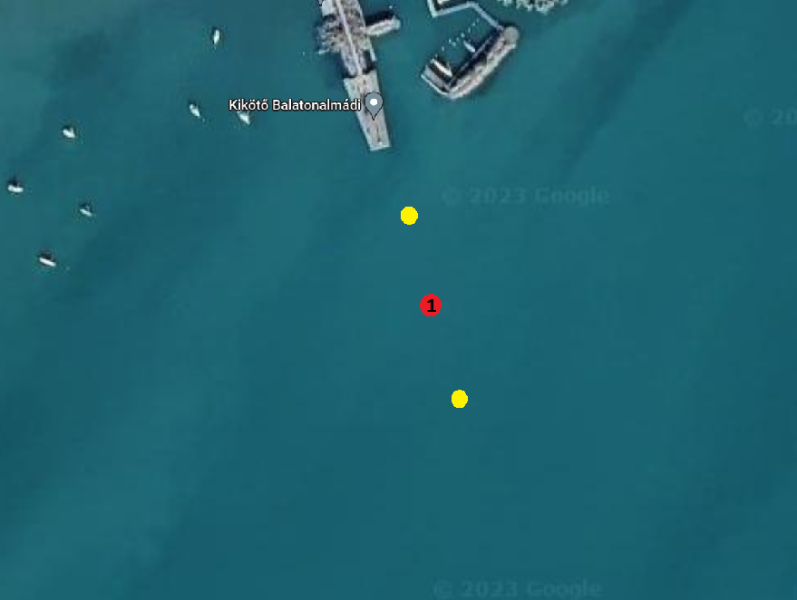
Ton’s Race start
Your race distance is the sum of all the sailed legs. Start in any direction.
  Possible legs are:
You can only sail a leg more than twice if you sailed at least 3 different legs.
After the finish give us a list of legs you completed.
SF | 5 | 5,77 km
SF | 1 | 11,46 km
SF | 3 | 6,67 km
3 | 4 | 5,73 km
1 | 5 | 5,63 km
SF
3
4
5
1

Slide 14
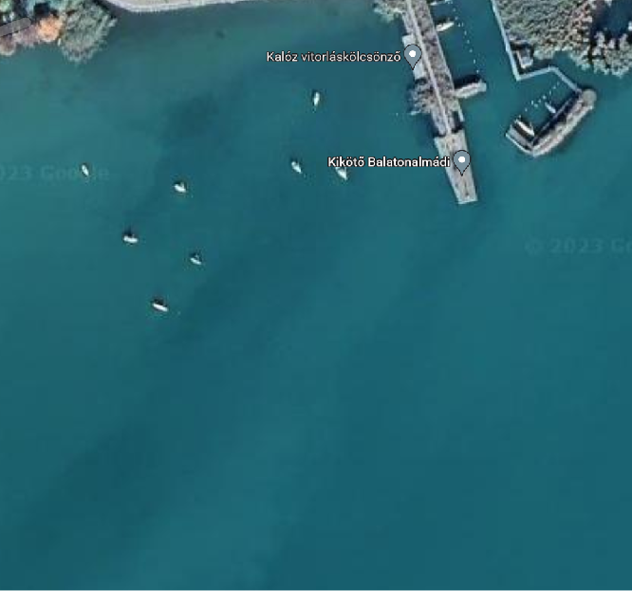
Match Race
(mark 2 approx 400 mtr)
Start schedule according to preliminary results
Course A | Course B
Start | Start
1 | 5
2 | 4
3 | 1
4 | 2
5 | 3
Finish | Finish
4
1
5
3
2

Slide 15
Match Race
stage | race | course A | course B
1 | 1 | O03 | O16
1 | 2 | O18 | O02
1 | 3 | O11 | O15
1 | 4 | O07 | O05
1 | 5 | O17 | O14
2 | 6 | 9 | 10
3 | 7 | 1 | 8
3 | 8 | 2 | 7
3 | 9 | 3 | 6
3 | 10 | 4 | 5
4 | 11 | R10L | R7L
4 | 12 | R9L | R8L
5 | 13 | R7W | R10W
5 | 14 | R8W | R9W
6 | 15 | R11L | R12L
7 | 16 | R12W | R11W
8 | 17 | R14L | R13L
9 | 18 | R13W | R14W
Stage 1: time trial, you will sail for the fastest time
Stage 2: place 9&10 from stage 1 will race for place 9
Stage 3: quarterfinals, result from stage 1: 1vs8, 2vs7, 3vs6, 4vs5
Stage 4: repechage losers from stage 3
Stage 5: semi-finals: winners from stage 3
Stage 6: losers from stage 4, winner gets 7th place, loser 8th
Stage 7: winners from stage 4, winner gets 5th place, loser 6th
Stage 8: petit final, losers of stage 5, winner is 3rd, loser 4th
Stage 9: final, winners of stage 5, winner is 1st, loser 2nd

Slide 16
Extra info
Official communication WhatsApp group!
Race will be covered through eStela, so download the app!
- Race officer: András Helmeczi
Coordinator jury tent: Tibor Szanka, Bendegúz Náray
Technical inspection: Tibor Szanka
- Emergency: 112
- Please tag @universityofpannonia in your socials

